Slide 1

Exploratory Data Analysis
TERM PROJECT
Rajkumar Bharathi G
https://github.com/RajkumarBharathi/Insaid2019_April_EDA
rkbharathi88@yahoo.com
9742332458

Slide 2
Pre-data analysis
Case Study : Car Sales (https://github.com/RajkumarBharathi/Insaid2019_April_EDA/blob/master/car_sales.csv)
Sales data corresponding to 9576 cars
10 columns in each row
Column Name | Description
car | Manufacturer Name
price | Price of the car in Dollars
body | Chassis type
mileage | Mileage of the car
engV | Engine Displacement in Litres
Column Name | Description
engType | Engine Type based on Fuel
registration | Registration status
year | Year of sale
model | Model name
drive | Drive type

Slide 3
data set profile
Sample data
There are 87 distinct car manufacturers
There are 888 distinct car models
There are 267 / 2.8% entries with zeros values for price – replaced with median price of model
There are 348 / 3.6% entries with zeros values for mileage – replaced with median value of engine type
Engine Volume has 434 / 4.5% missing values - replaced with mode value of body type
Drive has 511 / 5.3% missing values Missing - with overall mode value of drive type
car | price | body | mileage | engV | engType | registration | year | model | drive
Ford | 15500.0 | crossover | 68 | 2.5 | Gas | yes | 2010 | Kuga | full
Mercedes-Benz | 20500.0 | sedan | 173 | 1.8 | Gas | yes | 2011 | E-Class | rear
Mercedes-Benz | 35000.0 | other | 135 | 5.5 | Petrol | yes | 2008 | CL 550 | rear

Slide 4
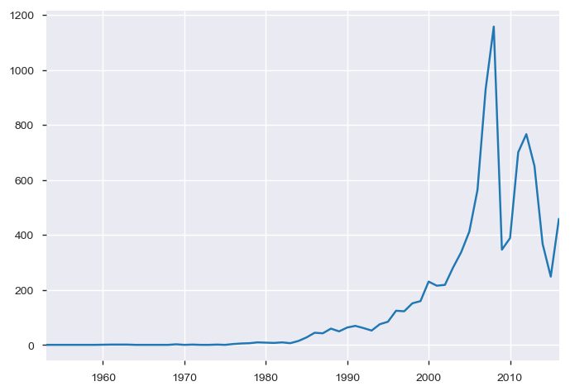
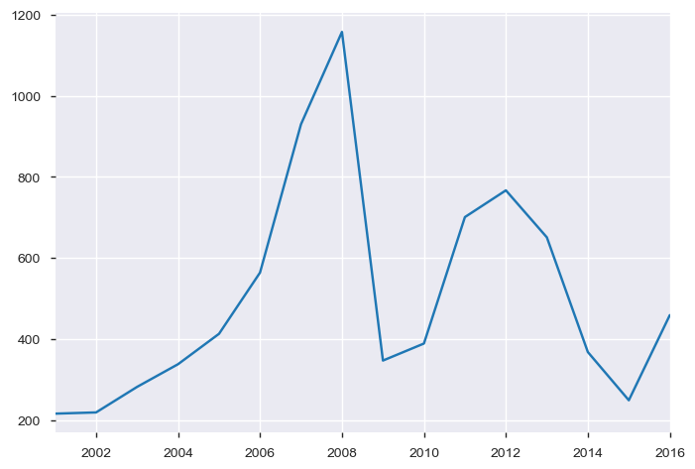
YEAR WISE SALES
2008 recorded the highest number of sales at 1158 units.

Slide 5
analysis based on car manufacturer
Sales Figures
Revenue Figures
Car Maker | No of Units
Volkswagen | 936
Mercedes-Benz | 921
BMW | 694
Toyota | 541
VAZ | 489
Renault | 469
Engine Type | Revenue ($)
Mercedes-Benz | 30,222,570
BMW | 16,527,710
Toyota | 12,554,710
Volkswagen | 12,278,790
Audi | 8,357,068
Land Rover | 8,263,275

Slide 6
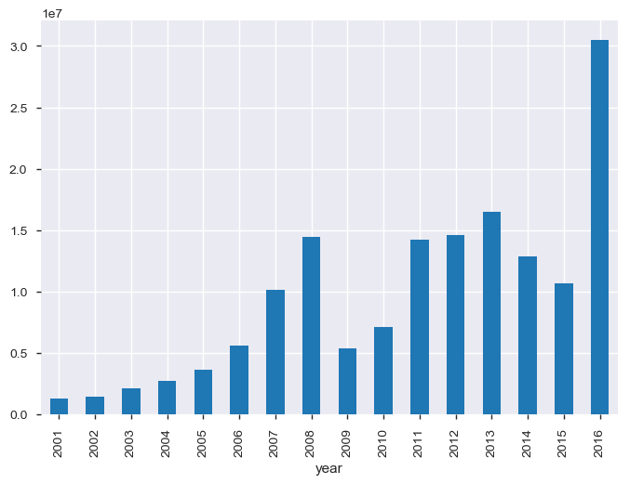
Year wise revenue from 2001
2016 had the highest revenue with 30,526,090 $
Between 2008 and 2009, there was a downfall in revenue by 9,103,020 $.

Slide 7
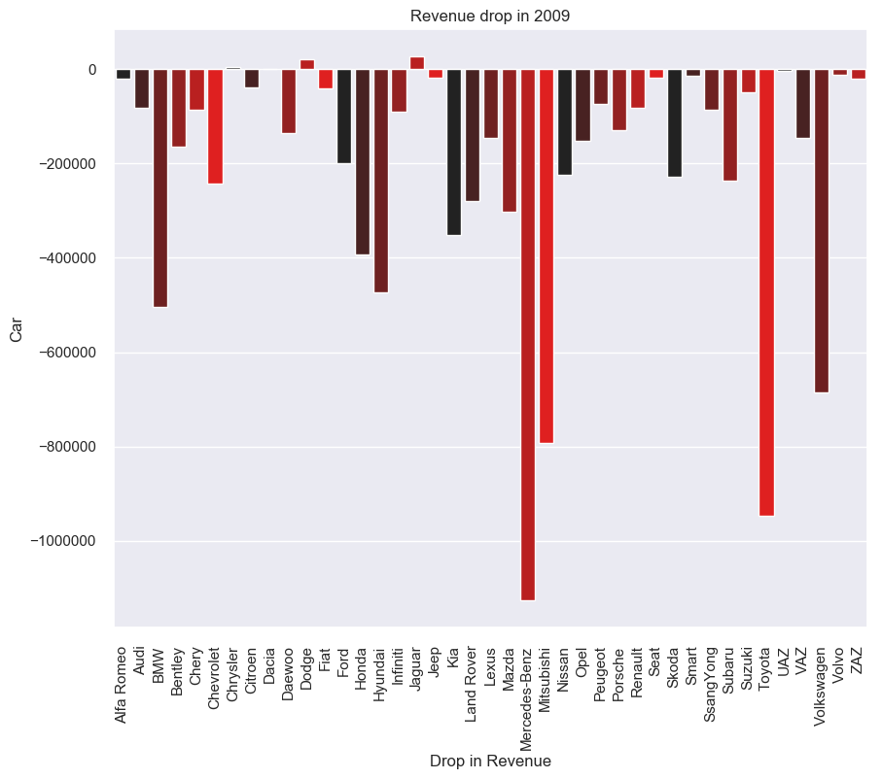
Loss of revenue in 2009
Mercedes-Benz was the worst affected with a loss of 1,126,277 $
Toyota suffered a loss of 946,332 $ and Mitsubishi with 791,515 $.

Slide 8
analysis based on BODY type
Sales Figures
Revenue Figures
Engine Type | No of Units
Sedan | 3646
Crossover | 2069
Hatch | 1252
Van | 1049
Vagon | 722
Other | 838
Engine Type | Revenue ($)
Crossover | 67,345,920
Sedan | 46,065,570
Hatch | 10,746,760
Van | 11,880,970
Vagon | 6,477,294
Other | 16,653,120

Slide 9
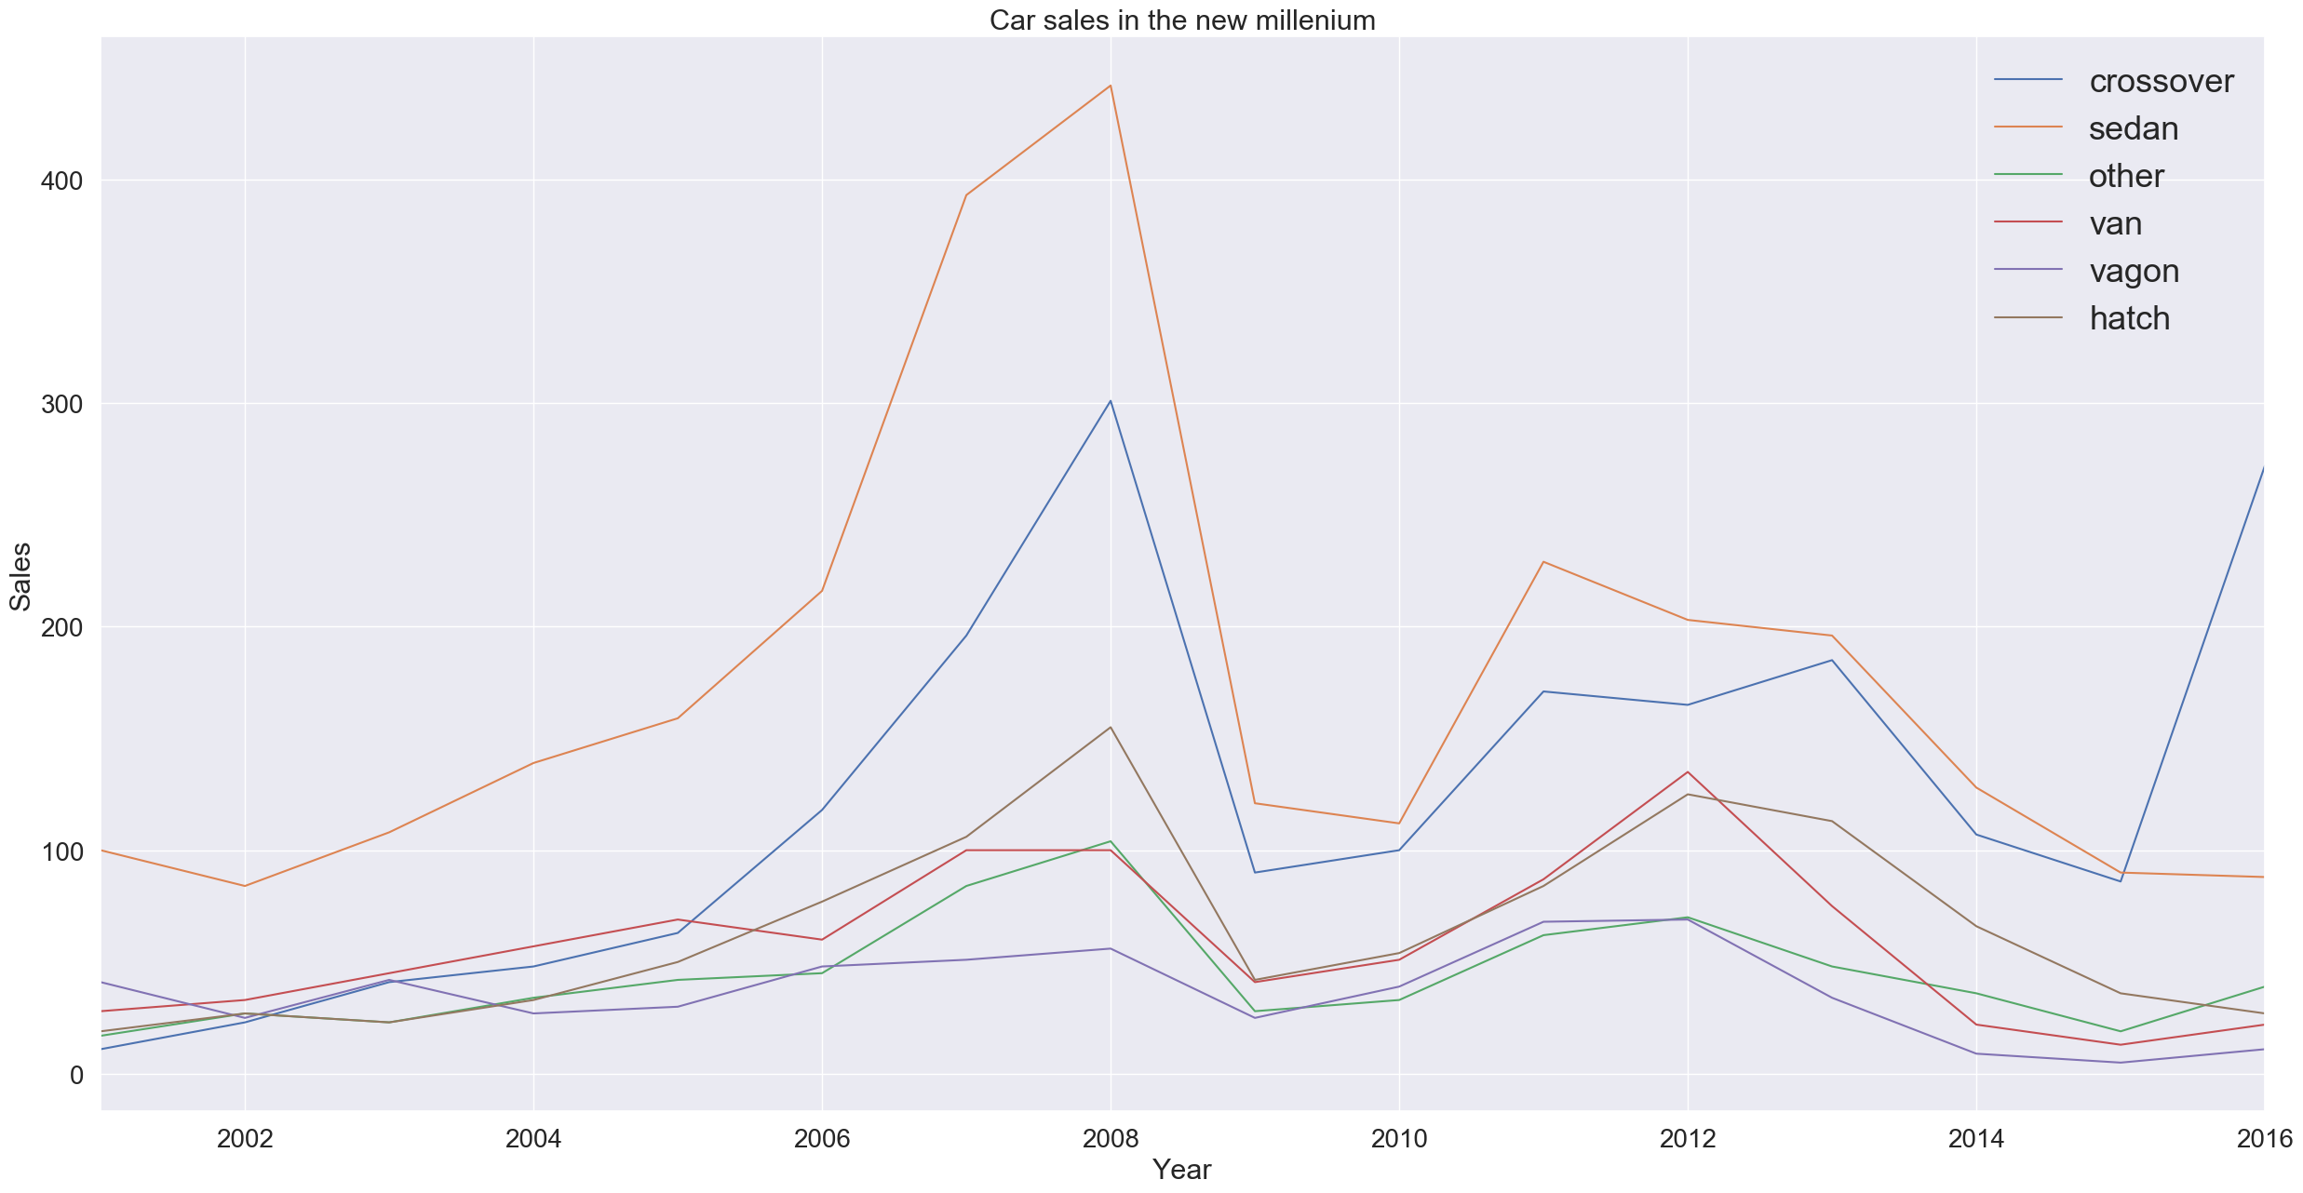
Sales based on Body (from year 2000)
Sedans are the largest selling segment followed by Crossover.
2009 saw downfall in sales across all segments.

Slide 10
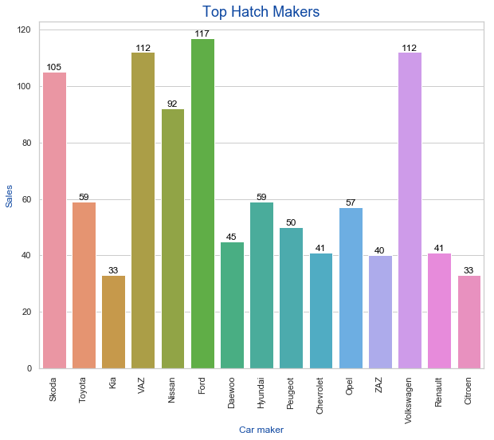
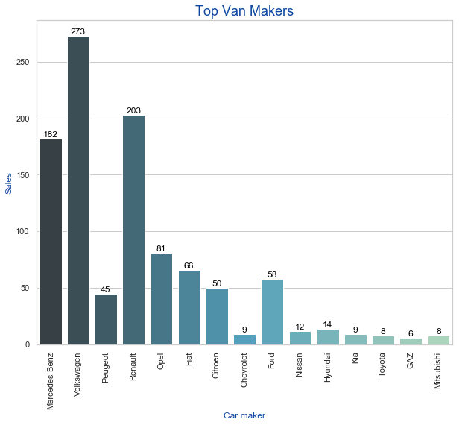
Body Type Specific sales
Ford is the top hatchback seller : 117
Volkswagen is the top Van maker : 273

Slide 11
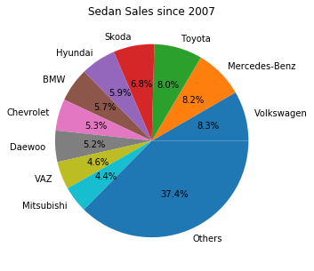
Sedan sales (from year 2007)
Volkswagen has the highest market share with 8.3%

Slide 12
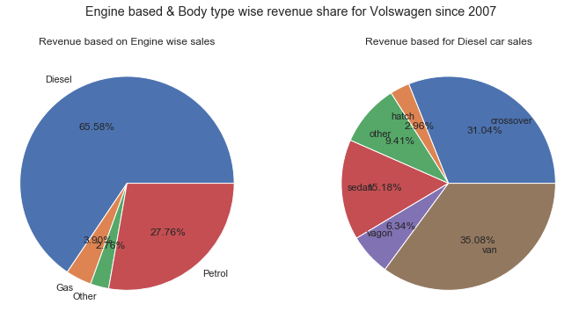
Volkswagen (from year 2007)
Diesel cars account for 65% of Volkswagen’s revenue.
Among Diesel cars sold by Volkswagen, Vans have 35.08% share of the income followed by Crossover SUV’s with 31.04% share.

Slide 13
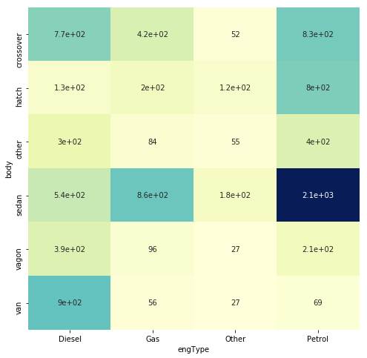
Engine V/S Body Correlation
Highest number of Gas based cars are Sedans followed by Crossover SUV
Maximum number of cars which run on Petrol are Sedans
Vans almost exclusively run on Diesel.
Most Hatchbacks run on Petrol

Slide 14
Sales based on engine type
Sales Figures
Revenue Figures
Engine Type | No of Units
Petrol | 4379
Diesel | 3013
Gas | 1722
Others | 462
Engine Type | Revenue ($)
Petrol | 73,793,680
Diesel | 60,327,040
Gas | 16,602,490
Others | 8,446,430

Slide 15
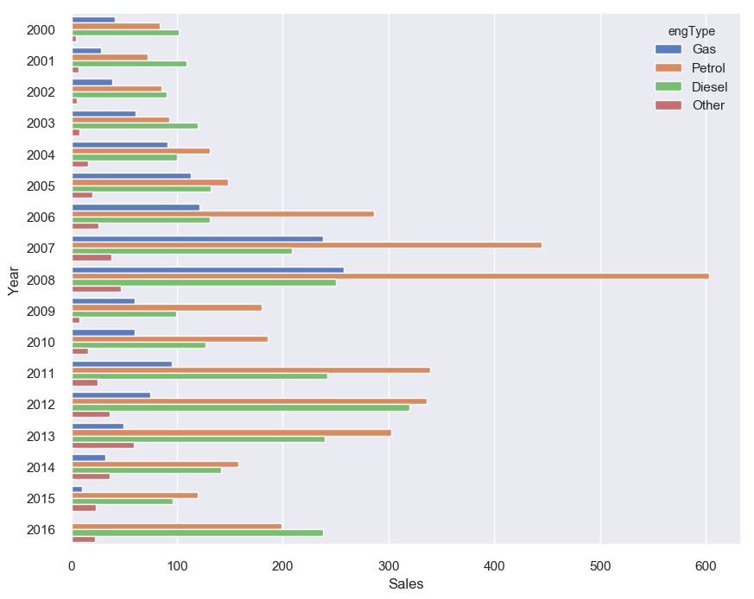
Sales based on engine type (from year 2000)
Petrol based cars are the most sold in the market

Slide 16
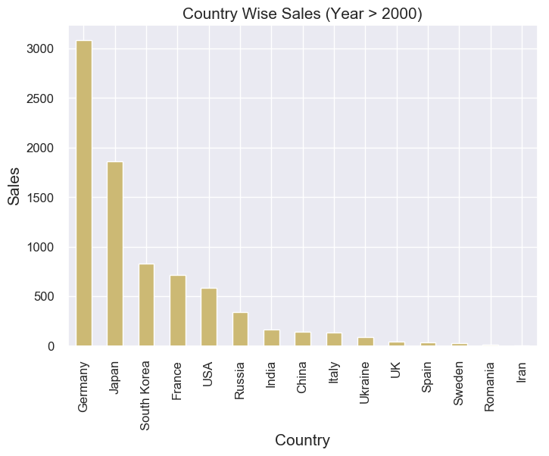
COUNTRY BASED ANALYSIS
Country | Sales
Germany | 3082
Japan | 1861
South Korea | 828

Slide 17
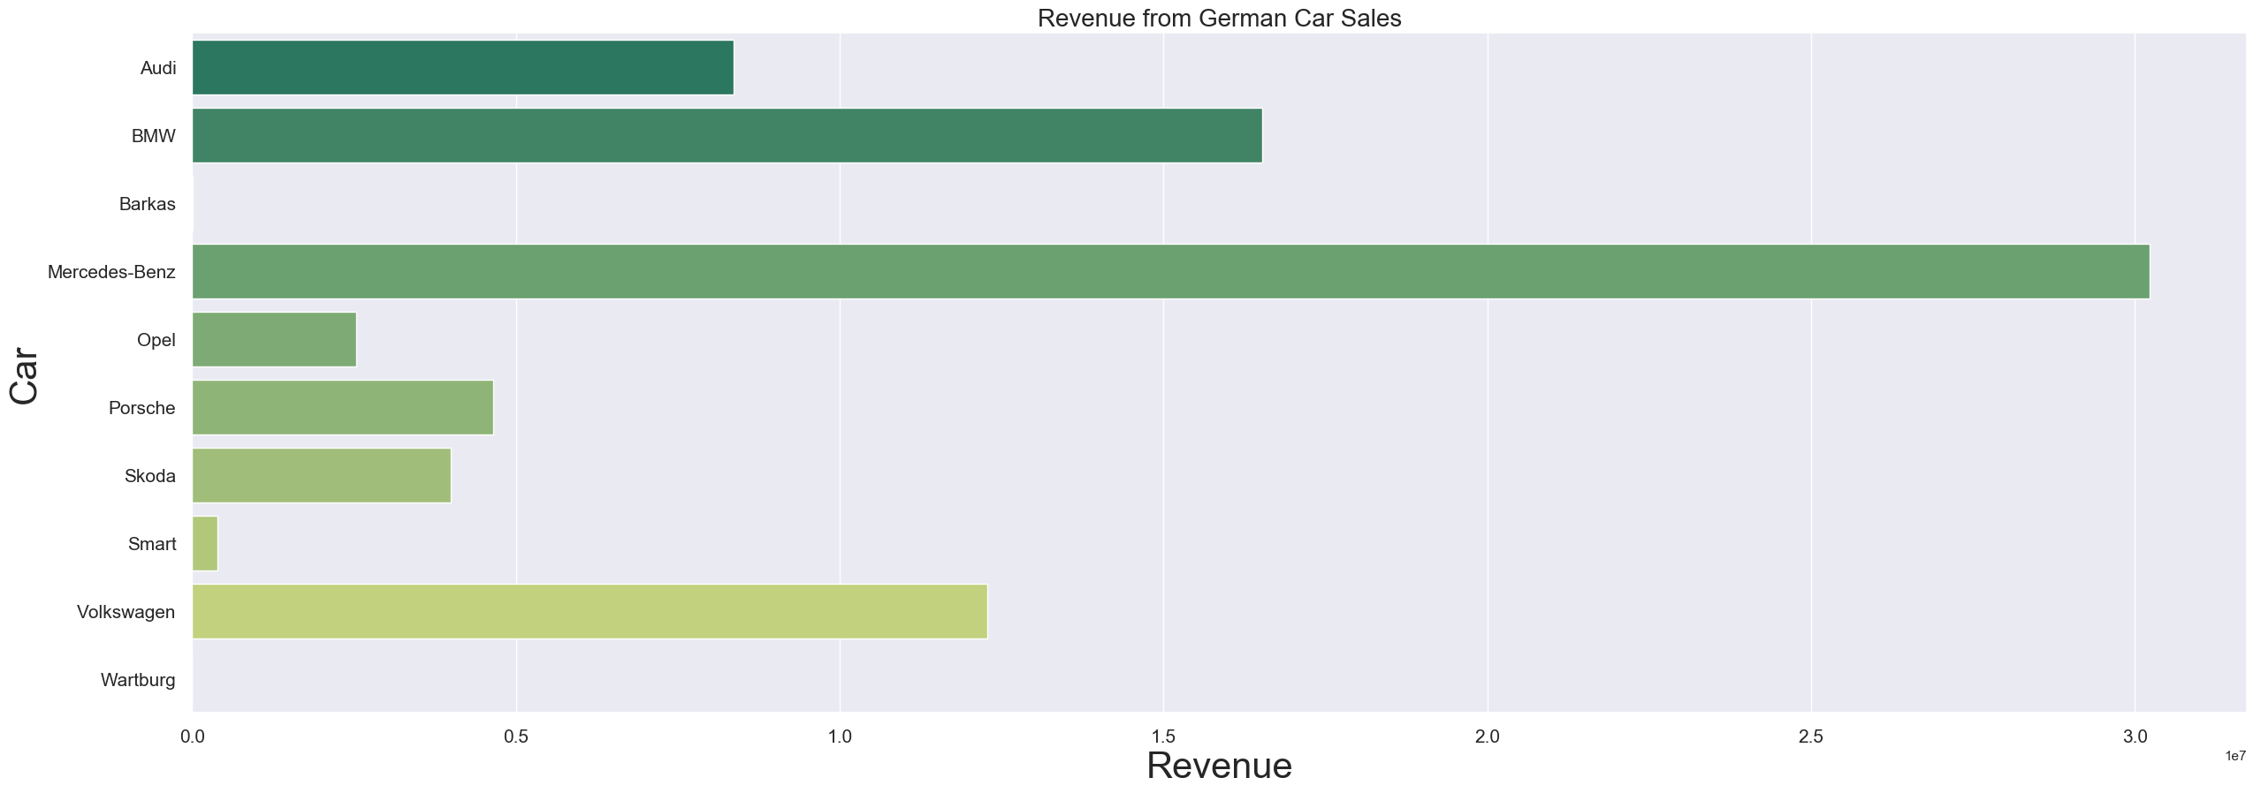
REVENUE FROM GERMAN CAR SALES
Car Maker | Revenue ($)
Mercedes Benz | 30,222.572
BMW | 16,527,707
Volkswagen | 12,278,789

Slide 18
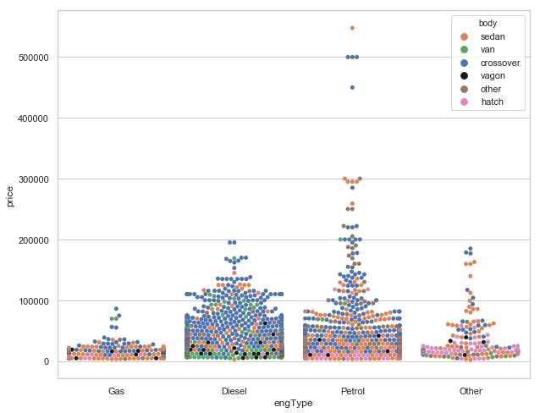
Price variation based on body type
Crossover SUV is typically very expensive while Gas engine cars are cheap

Slide 19
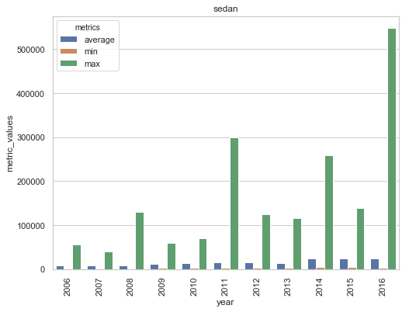
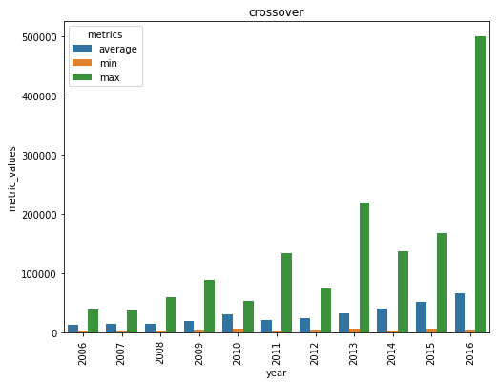
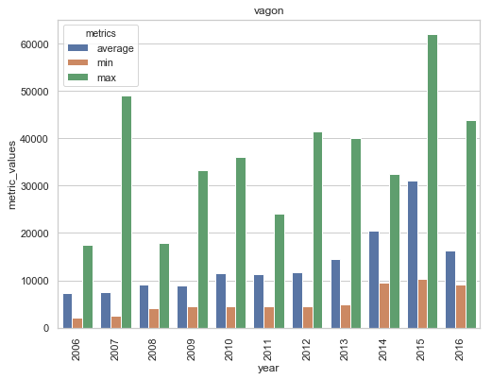
Price Metrics
Average price increases over time

Slide 20
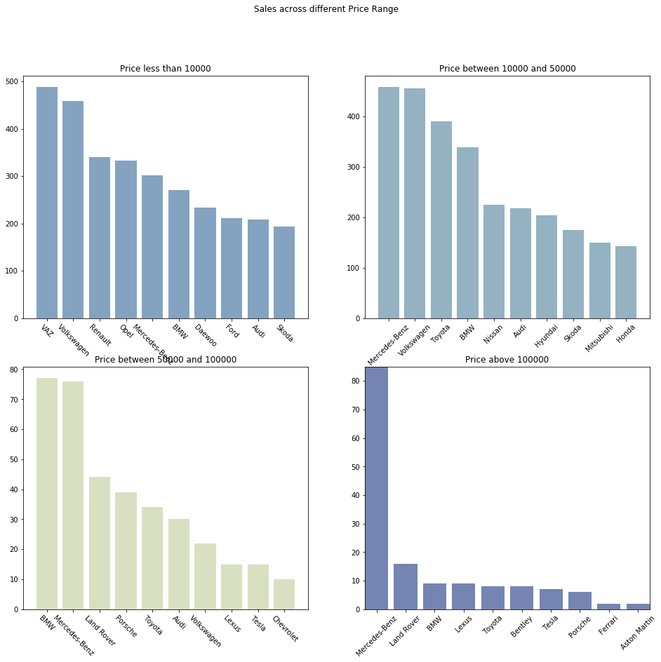
Sales across price segments
Less than 10000 : VAZ
10000 – 50000 : Mercedez-Benz
50000 – 100000 : BMW
Above 100000 : Mercedez-Benz

Slide 21
BEST SELLING MODELS since 2000
Based on Body Type
Based on calendar year
Chassis type | Model | No of Units
Crossover | BMW X5 | 113
Hatch | Nissan Leaf | 53
Sedan | Toyota Camry | 122
Vagon | Renault Megane | 53
Van | Mercedes-Benz Vito NACC | 88
Others | Smart Fortwo | 37
Year | Model | No of Units
2011 | Skoda Octavia A5 | 18
2012 | Skoda Octavia A5 | 42
2013 | Nissan Leaf | 26
2014 | Nissan Leaf | 18
2015 | Toyota Camry | 14
2016 | BMW X5 | 27

Slide 22
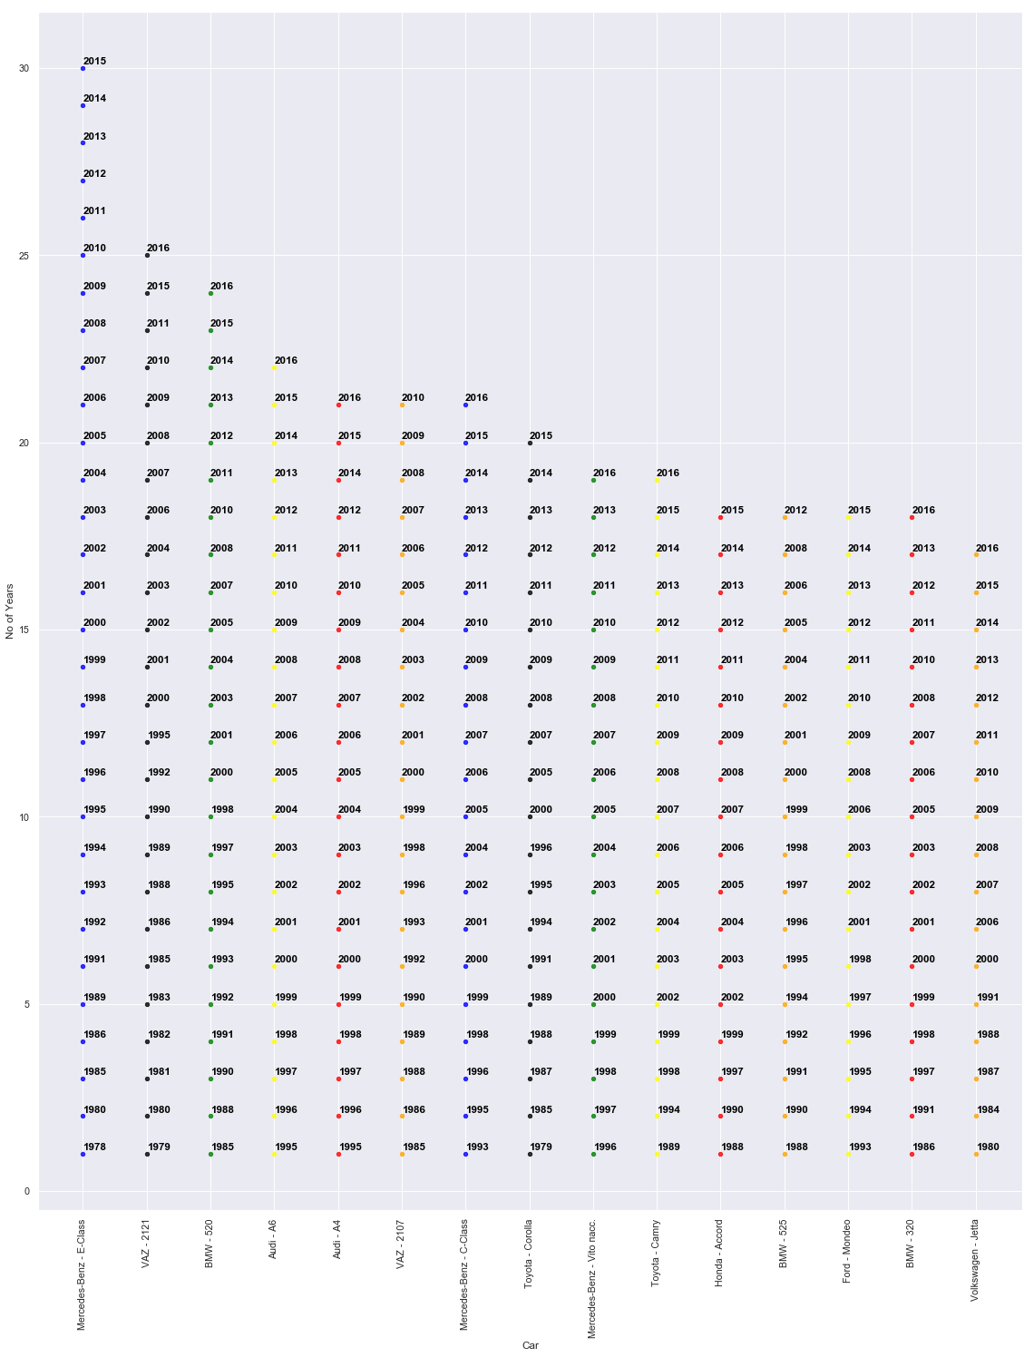
LONGEST SELLING MODELS
Mercedes Benz - E Class : 30 years
VAZ 2121 : 25 years
BMW 520 : 24 years

Slide 23
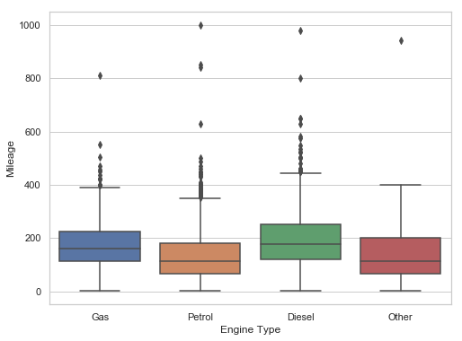
Mileage Based on fuel type
Diesel cars provide the best average mileage

Slide 24
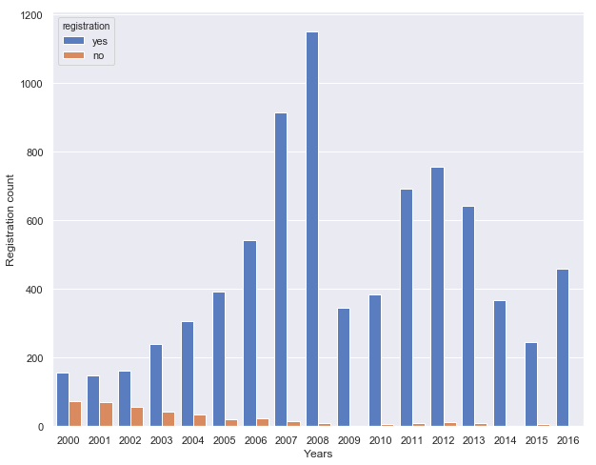
Year Wise Registration
Number of non-registered cars have progressively decreased over time

Slide 25
THANK YOU

